Slide 1
Lecture 13 Shortest Paths
Department of Computer Science
Hofstra University
Acknowledgement: Lecture slides based on UofW Course on Data Structures

Slide 2
BFS for (Unweighted) Shortest Path Problem
BFS (Breadth-First Search) can find shortest paths in an unweighted graph
BFS visits nodes in order of their distance from the source node, ensuring the first path found to any node is the shortest possible path in terms of the number of edges
Time complexity: O(V+E)
Advantages:
Optimal for unweighted graphs
Simple implementation
Limitations:
Only works for unweighted graphs
(Unweighted) Shortest Path Problem
Given source node s (start) and a target node t, how long is the shortest path from s to t? What edges makeup that path?
Notes:
Not suitable for graphs with negative edges

Slide 3
BFS for Shortest Paths in an Unweighted Graph
...
Map<Node, Edge> PN = ...
Map<Node, Double> SD = ...
PN.put(start, null);
SD.put(start, 0.0);
while (!perimeter.isEmpty()) {
Node from = perimeter.remove();
for (Edge edge : graph.edgesFrom(from)) {
Node to = edge.to();
if (!visited.contains(to)) {
PN.put(to, edge);
SD.put(to, SD.get(from) + 1);
perimeter.add(to);
visited.add(to);
}
}
}
return PN;
}
Keep track of how far each node is from the start with two maps
SD: Shortest Distance from source node
PN: Previous Node stores backpointers: each node remembers what node was used to arrive at it
PERIMETER
A
B
C
D
E
SD
2
E
VISITED
0
start
A
1
C
PN
1
B
2
D
Notes:
The start required no edge to arrive at, and is on level 0
Remember how we got to this point, and what layer this node is part of

Slide 4
Shortest Path Tree
SD
2
E
VISITED
0
The table of SD/PN contains the Shortest Path Tree, which encodes the shortest path and distance from start to every other node
Shortest path to any node can be obtained from SPT
Length of shortest path from A to D?
Lookup in SD map: 2
What’s the shortest path from A to D?
Build the path backwards from PN: start at D, follow backpointer to B, follow backpointer to A – the shortest path is ABD
start
A
1
C
PN
1
B
2
D
Node | SD | PN
A | 0 | /
B | 1 | A
C | 1 | A
D | 2 | B or C
E | 2 | C
Depending on the order of visiting A’s successors with BFS: either B before C, or C before B, D’s PN may be either B or C
Notes:
A general concept: in this implementation, made up of distances and backpointers

Slide 5
Dijkstra’s Algorithm
Named after its inventor, Edsger W. Dijkstra (1930-2002)
1972 Turing Award
Solves the Shortest Path Problem on a weighted graph
start
A
14.0
C
target
12.0
1.5
B
D
9000.2
Notes:
Suppose we want to find shortest path from A to C, using weight of each edge as “distance”
The idea: reminiscent of BFS, but adapted to handle weights
Nodes not in the set will have a “best distance so far”

Slide 6

Edge Relaxation
Relax edge e = u→v with weight w(u,v). (We also write edge uv to denote u→v)
SD[u] is length of shortest known path from s to u.
SD[v] is length of shortest known path from s to v.
PN[v] is the previous node on shortest known path from s to v.
If e = u→v gives shorter path to v through u, update SD[v] and PN[v].
SD[v] = min(SD[v], SD[u] + w(u,v)); PN[v]=u
After relaxing edge uv, the shortest path from s to v is updated to go through node u, with cost of 4.4
private void relax(DirectedEdge e)
{
Int u = e.from(), v = e.to();
if (SD[v] > SD[u] + w(u,v))
{
SD[v] = SD[u] + w(u,v);
PN[v] = u;
}
}
PN[v]=u
3.1
u
1.3
s
v
7.2
OLD PN(v)=x, SD[v] = 7.2 > SD[u] + w(u,v) = 3.1+1.3 = 4.4
NEW SD[v] ← SD[u] + w(u,v) = 4.4, PN[v] = u
x
Previous shortest path from s to v goes through node x, with cost of 7.2
Notes:
Dijkstra’s Algorithm is greedy and optimal: any node that has been visited should have its shortest distance to the source.

Slide 7
Generic Shortest-paths Algorithm
Generic algorithm (to compute SPT from s)
For each node v: SD[v] = ∞.
For each node v: PN[v] = null.
SD[s] = 0.
Repeat until done:
- Relax any edge.
Proposition. Generic algorithm computes SPT (if it exists) from s.
Pf.
Throughout algorithm, SD[v] is the length of a simple path from s to v (and PN[v] is its previous node on the path).
Each successful relaxation decreases SD[v] for some v.
The entry SD[v] can decrease at most a finite number of times.
Efficient implementations. How to choose which edge to relax?
Ex 1. Dijkstra’s algorithm. (no negative weights)
Ex 2. Bellman–Ford algorithm. (negative weights, can detect negative cycles)
Ex 3. Topological sort. (DAG with no directed cycles)
Notes:
Ex 2. Topological sort algorithm. (no directed cycles).

Slide 8
Dijkstra's Algorithm
Initialization:
Set the distance to the source node as 0 and to all other nodes as infinity.
Mark all nodes as unvisited and store them in a priority queue.
Main Loop:
Visit the unvisited node u with the shortest known distance (minimum SD) from the queue.
For each unvisited neighbor node v of node u, calculate its tentative distance through the current node. If this distance is smaller than the previously recorded distance, update it with edge relaxation for edge uv.
Mark the current node as visited once all its neighbors are processed.
Termination:
The algorithm continues until all reachable nodes are visited.
Notes:
Greedy and optimal algorithm: any node that has been visited should have its shortest distance to the source.
It works for both undirected and directed graphs. The only difference is how to get neighbors of node v, as each undirected edge is treated as two directed edges in both directions.
Notes:
which follows the edge arrow direction for directed graphs

Slide 9
Dijkstra’s Algorithm: Idea
PERIMETER
2
4??
UNKNOWN
0
2
2
3
∞
start
A
B
F
H
1
4
5
10
2
∞
1
9
1
3
G
4
2
C
KNOWN
D
11
1
E
7
12??
Initialization:
Start node has distance 0; all other nodes have distance ∞
At each step:
Pick the closest unknown node v (with smallest SD)
Add it to the “cloud” of known nodes (set of nodes whose shortest distance has been computed)
Update “best-so-far” distances for nodes with edges from v

Slide 10
Dijkstra’s Pseudocode (High-Level)
0
KNOWN
start
A
2
2
PERIMETER
B
5
Suppose we already visited B, SD[D] = 7
Now considering edge (C, D):
oldDist = 7
newDist = 3 + 1
Relaxation updates SD[D], PN[D]
3
3
7??
Similar to “visited” in BFS, “known” is set of nodes that have been visited and we know shortest paths to them
C
u
1
v
D
dijkstraShortestPath(G graph, V start)
Set known; Map PN, SD;
Init all paths to infinite.
initialize SD with all nodes mapped to ∞, except start to 0
while (there are unknown nodes):
let u be the closest unknown node
known.add(u);
Greedy algo: visit closest node first
for each edge (u,v) from u with weight w:
oldDist = SD.get(v) // previous best path to v
newDist = SD.get(u) + w // what if we went through u?
Consider all nodes reachable from the newly-added node u: would getting there through u be a shorter path than their current path length?
if (newDist < oldDist):
SD.put(v, newDist)
PN.put(v, u)
Notes:
Dijkstra’s algorithm is all about updating “best-so-far” in SD if we find shorter path!

Slide 11
Dijkstra’s Algorithm: Key Properties
Once a node is marked known, its shortest path is known. Can reconstruct path by following back-pointers (in PN map)
dijkstraShortestPath(G graph, V start)
Set known; Map PN, SD;
initialize SD with all nodes mapped to ∞, except start to 0
while (there are unknown nodes):
let u be the closest unknown node
known.add(u)
for each edge (u,v) to unknown v with weight w:
oldDist = SD.get(v) // previous best path to v
newDist = SD.get(u) + w // what if we went through u?
if (newDist < oldDist):
SD.put(v, newDist)
PN.put(v, u)
While a node is not yet visited/known, another shorter path might be found. We call this update relaxing the distance because it only ever shortens the current best path
Being greedy and visiting the closest node first, means that no shorter path will be found later once a node is marked known
Notes:
It is not possible to find a shorter path that uses a farther node we’ll consider later

Slide 12
Dijkstra’s Algorithm: Runtime
dijkstraShortestPath(G graph, V start)
Set known; Map PN, SD;
initialize SD with all nodes mapped to ∞, except start to 0
while (there are unknown nodes):
let u be the closest unknown node
known.add(u)
for each edge (u,v) to unknown v with weight w:
oldDist = SD.get(v) // previous best path to v
newDist = SD.get(u) + w // what if we went through u?
if (newDist < oldDist):
SD.put(v, newDist)
PN.put(v, u)
update distance in list of unknown nodes
O(V)
O(V)
O(log V) using binary min-heap implementation of a priority queue
O(E)
O(log V)
Initialization: O(V)
Extracting nodes: O(V log V)
Edge relaxations: O(E log V)
Total runtime: O((V+E) log V)
Notes:
We can use an optimized structure that will tell us the “minimum” distance node, and let us “update distance” as we go… Use a HeapMinPriorityQueue! (like the one from P3)

Slide 13
Example I
0
2
∞
∞
∞
start
B
2
3
A
F
H
1
4
5
10
2
∞
1
9
∞
3
G
∞
2
C
11
∞
D
1
E
Node | SD | PN
A | 0 | /
B | ∞
C | ∞
D | ∞
E | ∞
F | ∞
G | ∞
H | ∞
7
Visit Order
Start from the source node A

Slide 14
Example I
0
2
2??
∞
∞
?? Means that SDs have not yet been finalized, as a shortcut may be found in the future.
start
B
2
3
A
F
H
1
4
5
10
2
∞
1
9
1??
3
G
4??
2
C
11
∞
D
1
E
Node | SD | PN
A | 0 | /
B | 2 | A
C | 1 | A
D | 4 | A
E | ∞
F | ∞
G | ∞
H | ∞
7
Visit Order
A
Visit C next, since C has the smallest SD of 1 among all unknown (unvisited) nodes

Slide 15
Example I
0
2
2??
∞
∞
start
B
2
3
A
F
H
1
4
5
10
2
∞
1
9
1
3
G
4??
2
C
11
12??
D
1
E
Node | SD | PN
A | 0 | /
B | 2 | A
C | 1 | A
D | 4 | A
E | 12 | C
F | ∞
G | ∞
H | ∞
7
Visit Order
A, C
Visit B next, since B has the smallest SD of 2 among all unvisited nodes
Notes:
Note how E’s distance is 12 (path length) instead of 11 (edge weight)

Slide 16
Example I
0
2
2
4??
∞
start
B
2
3
A
F
H
1
4
5
10
2
∞
1
9
1
3
G
4??
2
C
11
12??
D
1
E
Node | SD | PN
A | 0 | /
B | 2 | A
C | 1 | A
D | 4 | A
E | 12 | C
F | 4 | B
G | ∞
H | ∞
7
Visit Order
A, C, B
We can choose to visit either D or F next, since they have the same smallest SD of 4 among all unvisited nodes. Let’s visit D
Notes:
Note how
Again, we don’t set F’s pathlen to 2 (the edge weight); we set it to 4 (length of A->B->F)
We don’t update C with distance 7 (A->B->C); its optimal path is already known
We don’t update E with distance 12 (A->B->E); the path length is the same

Slide 17
Example I
0
2
2
4??
∞
start
B
2
3
A
F
H
1
4
5
10
2
∞
1
9
1
3
G
4
2
C
11
12??
D
1
E
Node | SD | PN
A | 0 | /
B | 2 | A
C | 1 | A
D | 4 | A
E | 12 | C
F | 4 | B
G | ∞
H | ∞
7
Visit Order
A, C, B, D
Visit F next, since F has the smallest SD of 4 among all unvisited nodes
Notes:
Nothing was updated; we already had an optimal path to C

Slide 18
Example I
0
2
2
4
7??
start
B
2
3
A
F
H
1
4
5
10
2
∞
1
9
1
3
G
4
2
C
11
12??
D
1
E
Node | SD | PN
A | 0 | /
B | 2 | A
C | 1 | A
D | 4 | A
E | 12 | C
F | 4 | B
G | ∞
H | 7 | F
7
Visit Order
A, C, B, D, F
Visit H next, since H has the smallest SD of 7 among all unvisited nodes

Slide 19
Example I
0
2
2
4
7
start
B
2
3
A
F
H
1
4
5
10
2
8??
1
9
1
3
G
4
2
C
11
12??
D
1
E
7
Node | SD | PN
A | 0 | /
B | 2 | A
C | 1 | A
D | 4 | A
E | 12 | C
F | 4 | B
G | 7 8 | 8 H
H | 7 | F
Visit Order
A, C, B, D, F, H
We found a shortcut to G going through H, so we update SD and PN for G. Visit F next, since F has the smallest SD of 4 among all unvisited nodes
Notes:
OLD SD[F] = $∞$ > SD[D] + w(D,F) = 7+2 = 9
NEW SD[F] ← SD[D] + w(D,F) = 9, PN[F] = D

Slide 20
Example I
0
2
2
4
7
start
B
2
3
A
F
H
1
4
5
10
2
8
1
9
1
3
G
4
2
C
11
11??
D
1
E
Node | SD | PN
A | 0 | /
B | 2 | A
C | 1 | A
D | 4 | A
E | 12 11 | C G
F | 4 | B
G | 7 8 | 8 H
H | 7 | F
7
Visit Order
A, C, B, D, F, H, G
We found a shortcut to E going through G, so we update SD and PN for E. Visit E next, since it is the last unvisited node
Notes:
Note how we found a better path to E at last (A->B->F->H->G->E), with cost 11; formerly path A->C->E had cost 12

Slide 21
Example I Final
2
The table now contains the SD (shortest distance) to each node N from the source node A, and its PN (previous node) in the shortest path. The table of SD/PN encodes the Shortest Path Tree (SPT)
0
2
2
4
7
start
A
B
F
3
H
1
4
5
10
2
8
1
9
1
3
G
4
2
C
11
11
D
1
E
Node | SD | PN
A | 0 | /
B | 2 | A
C | 1 | A
D | 4 | A
E | 12 11 | C G
F | 4 | B
G | 7 8 | 8 H
H | 7 | F
7
Visit Order
A, C, B, D, F, H, G, E
All nodes have now been visited and are known
Notes:
Done!

Slide 22
Example I: Interpreting the Results
0
2
2
4
7
How to get the shortest path from A to E?
Follow PN backpointers to get path ABFHGE
start
B
2
3
A
F
H
1
4
5
10
2
8
1
9
1
3
G
4
2
C
11
11
D
1
E
Node | SD | PN
A | 0 | /
B | 2 | A
C | 1 | A
D | 4 | A
E | 11 | G
F | 4 | B
G | 8 | H
H | 7 | F
7
Visit Order
A, C, B, D, F, H, G, E
Notes:
Walk through the chain of “previous” (E->G->H->F->B->A)

Slide 23
Example I Exam Question and Answer
Exam question: Given this directed graph, run Dijkstra’s Algo to find shortest paths starting from source node A. Give the node visit order, and fill in this table of SN (Shortest Distance) and PN (Previous Node), crossing out old SD and PN as you find a shortcut path with smaller SD
Visit Order
A, C, B, D, F, H, G, E
Node | SD | PN
A | 0 | /
B | 2 | A
C | 1 | A
D | 4 | A
E | 12 11 | C G
F | 4 | B
G | 7 8 | 8 H
H | 7 | F
2
2
3
start
A
B
F
H
1
4
5
10
2
1
9
3
G
2
C
11
D
1
E
7
Notes:
At exam time, you will be given a graph with a start node (A), and required to fill in this table, crossing out old items as you find a shortcut path

Slide 24
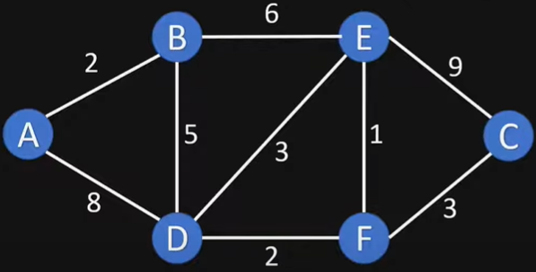
Example II
Dijkstras Shortest Path Algorithm Explained | With Example | Graph Theory
https://www.youtube.com/watch?v=bZkzH5x0SKU

Slide 25
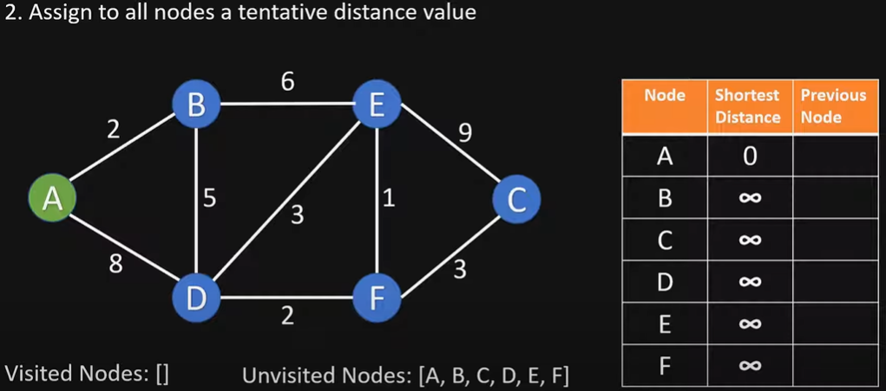
Initialize

Slide 26
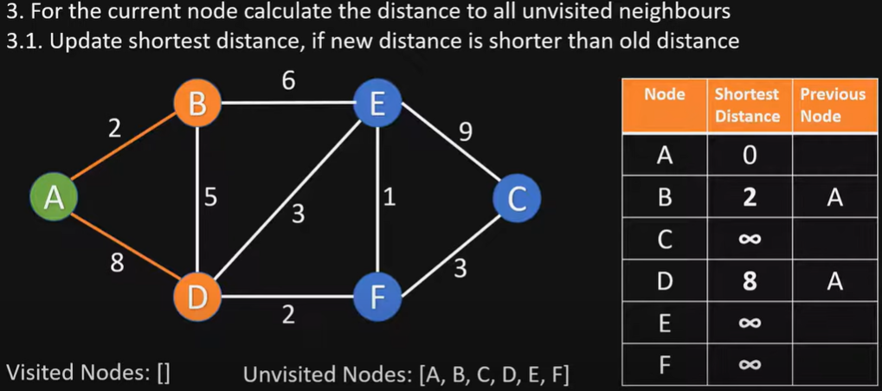
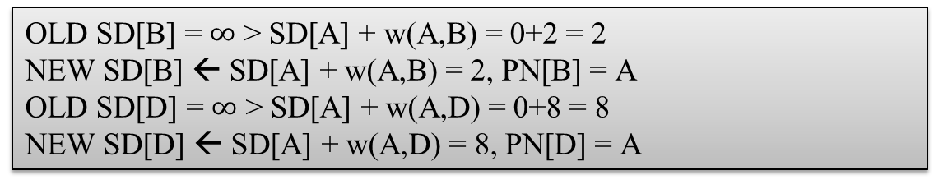
Visit node A
OLD SD[B] = $∞$ > SD[A] + w(A,B) = 0+2 = 2
NEW SD[B] ← SD[A] + w(A,B) = 2, PN[B] = A
OLD SD[D] = $∞$ > SD[A] + w(A,D) = 0+8 = 8
NEW SD[D] ← SD[A] + w(A,D) = 8, PN[D] = A

Slide 27
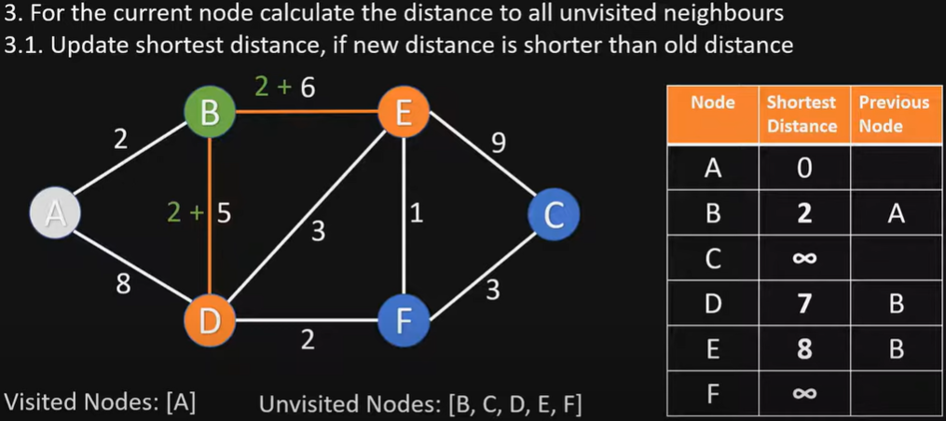
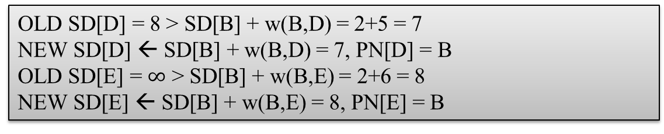
Visit node B
OLD SD[D] = 8 > SD[B] + w(B,D) = 2+5 = 7
NEW SD[D] ← SD[B] + w(B,D) = 7, PN[D] = B
OLD SD[E] = $∞$ > SD[B] + w(B,E) = 2+6 = 8
NEW SD[E] ← SD[B] + w(B,E) = 8, PN[E] = B

Slide 28
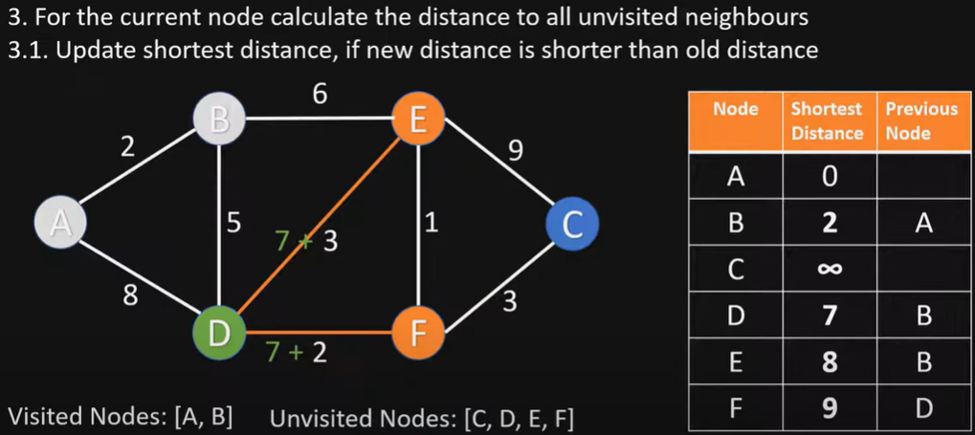
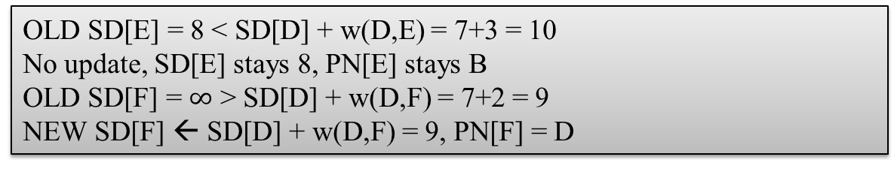
Visit node D
OLD SD[E] = 8 < SD[D] + w(D,E) = 7+3 = 10
No update, SD[E] stays 8, PN[E] stays B
OLD SD[F] = $∞$ > SD[D] + w(D,F) = 7+2 = 9
NEW SD[F] ← SD[D] + w(D,F) = 9, PN[F] = D

Slide 29
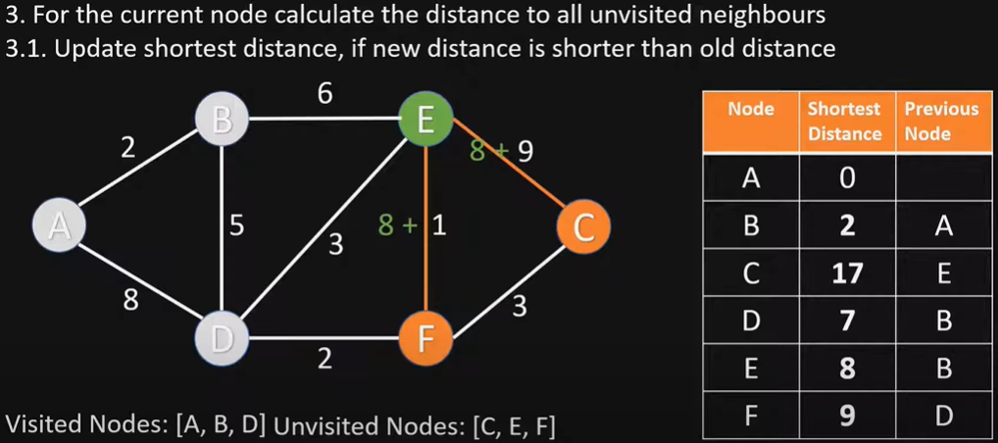
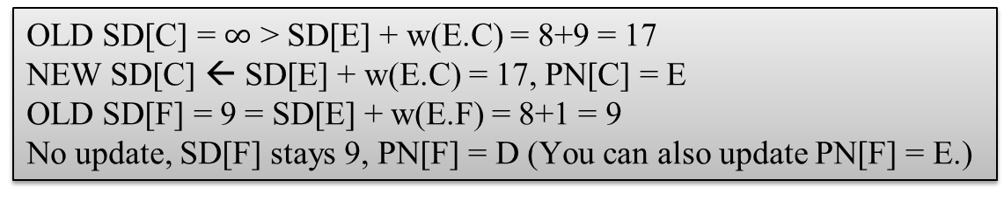
Visit node E
OLD SD[C] = $∞$ > SD[E] + w(E.C) = 8+9 = 17
NEW SD[C] ← SD[E] + w(E.C) = 17, PN[C] = E
OLD SD[F] = 9 = SD[E] + w(E.F) = 8+1 = 9
No update, SD[F] stays 9, PN[F] = D (You can also update PN[F] = E.)

Slide 30
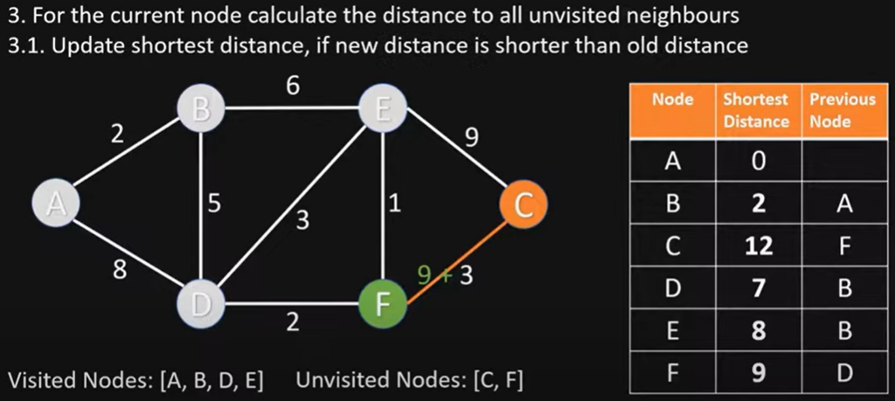
Visit node F
OLD SD[C] = 17 > SD[F] + w(F,C) = 9+3 = 12
NEW SD[C] ← SD[F] + w(F,C) = 12, PN[C] = F

Slide 31
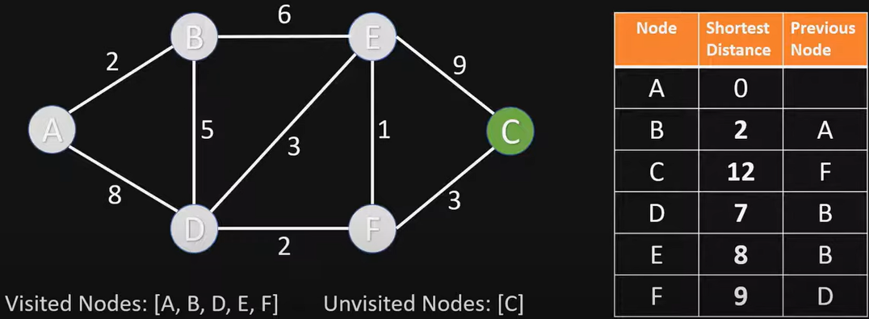
Visit node C
Nothing changes, since C has no unvisited neighbor nodes

Slide 32
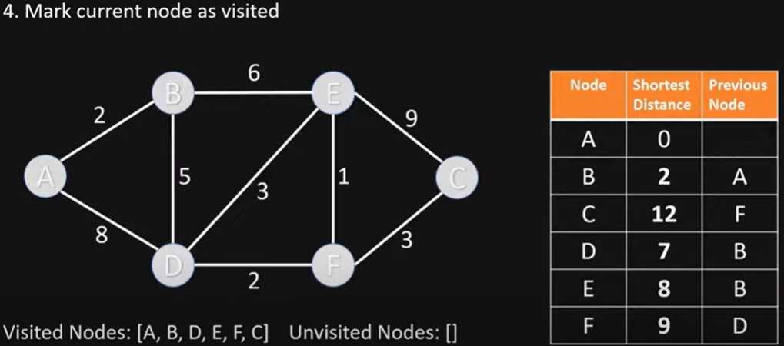
End of Algorithm
The table now contains the SD (shortest distance) to each node N from the source node A, and its PN (previous node) in the shortest path

Slide 33
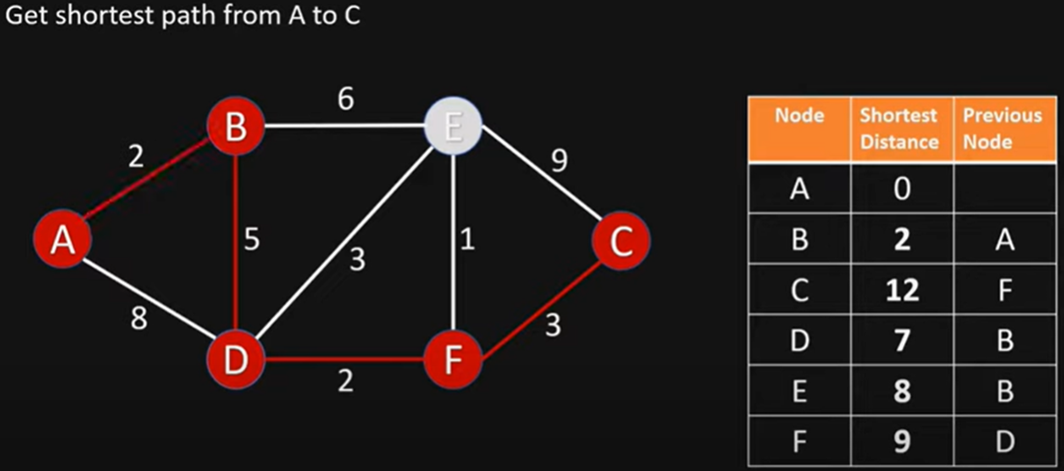
Getting the Shortest Path from A to C
C’s previous node is F; F’s previous node is D; D’s previous node is B; B’s previous node is A
Shortest Path from A to C is ABDFC

Slide 34
Example II Exam Question and Answer
Exam question: Given this directed graph, run Dijkstra’s Algo to find shortest paths starting from source node A. Give the node visit order, and fill in this table of SN (Shortest Distance) and PN (Previous Node), crossing out old SD and PN as you find a shortcut path with smaller SD
Visit Order
A, B, D, E, F, C
Node | SD | PN
A | 0 | /
B | 2 | A
C | 17 12 | E F
D | 8 7 | A B
E | 8 | B
F | 9 | D
Notes:
At exam time, you will be given a graph with a start node (A), and required to fill in this table, crossing out old items as you find a shortcut path

Slide 35
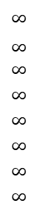
Example III
choose node 5
relax all edges adjacent from 5
choose node 2
relax all edges adjacent from 2
choose node 3
relax all edges adjacent from 3
choose node 6
relax all edges adjacent from 6
1
v SD
Visit Order
0, 1, 7, 4, 5, 2, 3, 6
15
3
$$∞$$
$∞$ $∞$
$$∞$$
$$∞$$
$$∞$$
$$∞$$
$$∞$$
0
5
17
20
9
14
29
8
15
17
13
26
14
25
0
1
2
3
4
5
6
7
5
4
12
0
3
Node | SD | PN
0 | 0 | /
1 | 5 | 0
2 | 17 15 14 | 1 7 5
3 | 20 17 | 1 2
4 | 9 | 0
5 | 14 13 | 7 4
6 | 29 26 25 | 4 5 2
7 | 8 | 0
8
7
2
7
9
9
5
6
1
5
11
v PN
4
4
13
6
0
1
2
3
4
5
6
7
-
-
-
-
-
-
-
-
0
1
1
0
7
4
0
7
2
4
5
5
2
20
choose source node 0
relax all edges adjacent from 0
choose node 1
relax all edges adjacent from 1
choose node 7
relax all edges adjacent from 7
choose node 4
relax all edges adjacent from 4
Notes:
Consider nodes in increasing order of distance from s
(non-tree node with the lowest SD[ ] value).
Add node to tree and relax all edges pointing from that node.

Slide 36
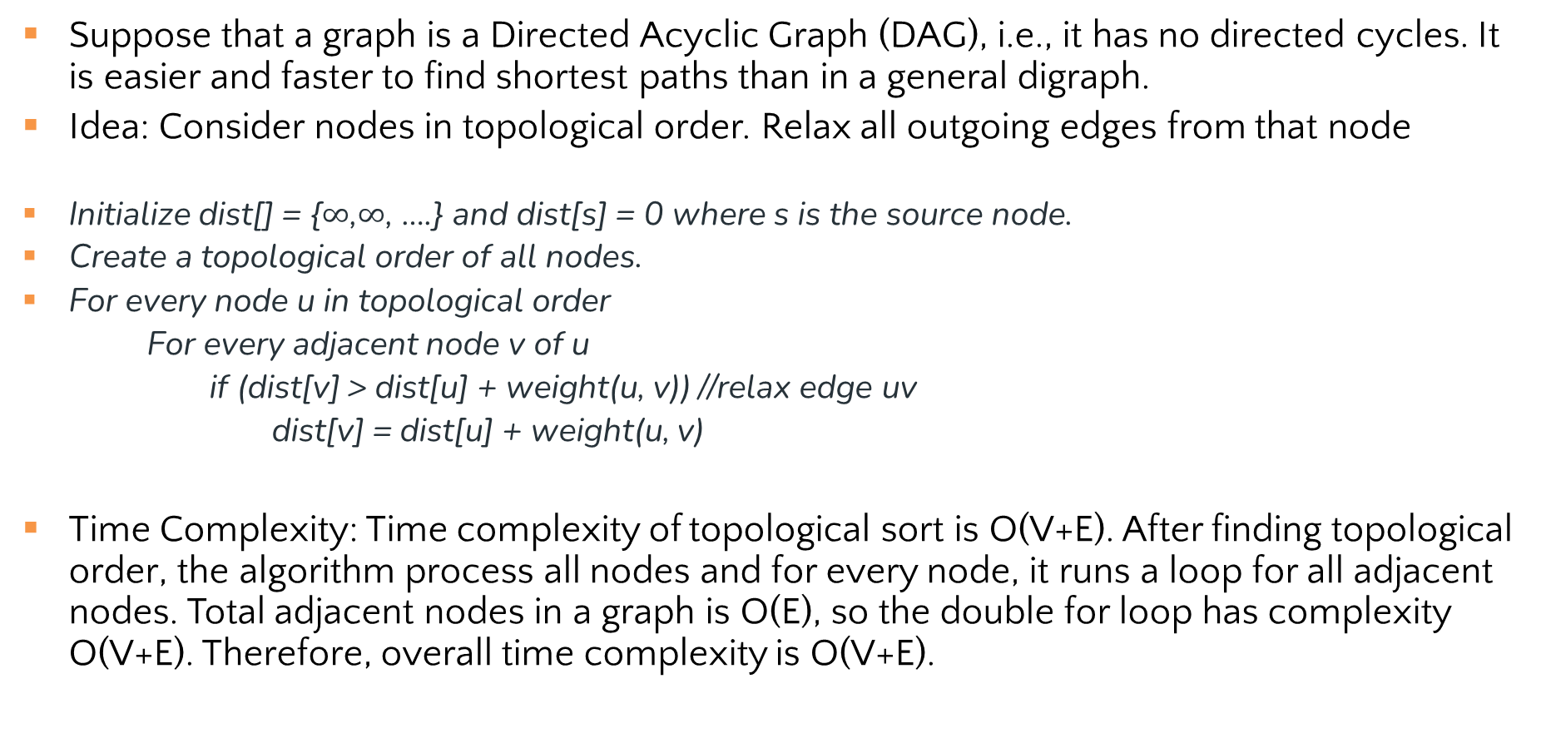
Topological Sort for Shortest Paths in DAG
Suppose that a graph is a Directed Acyclic Graph (DAG), i.e., it has no directed cycles. It is easier and faster to find shortest paths than in a general digraph.
Idea: Consider nodes in topological order. Relax all outgoing edges from that node
Initialize dist[] = {$∞$,$∞$, ….} and dist[s] = 0 where s is the source node.
Create a topological order of all nodes.
For every node u in topological order
For every adjacent node v of u
if (dist[v] > dist[u] + weight(u, v)) //relax edge uv
dist[v] = dist[u] + weight(u, v)
Time Complexity: Time complexity of topological sort is O(V+E). After finding topological order, the algorithm process all nodes and for every node, it runs a loop for all adjacent nodes. Total adjacent nodes in a graph is O(E), so the double for loop has complexity O(V+E). Therefore, overall time complexity is O(V+E).

Slide 37
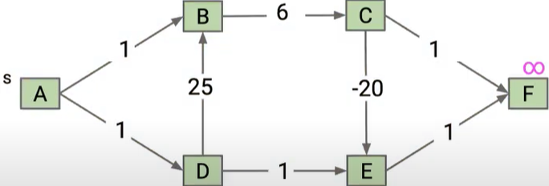
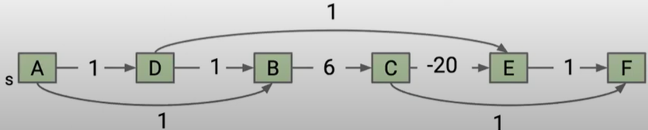
Topological Sort Example I
Consider this DAG, use Topological Sort to find Shortest Paths in DAG, considering the topological order ADBCEF (Different topological orders will result in different algorithm process, but final results will be the same)

Slide 38
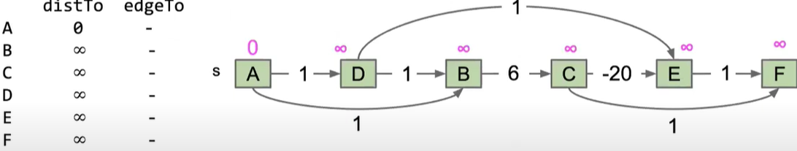
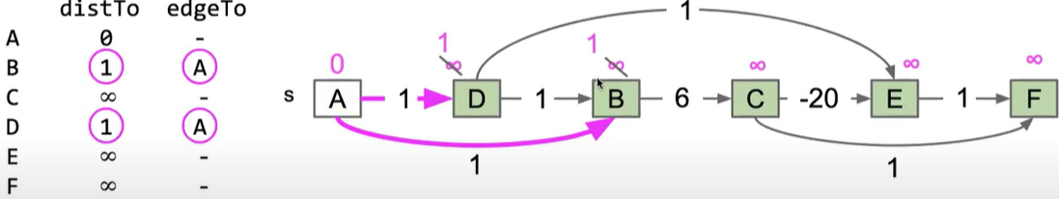
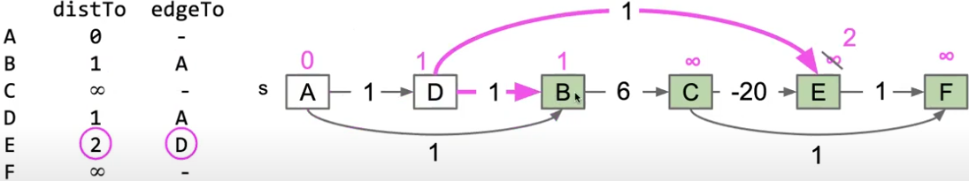
Here we use distTo to denote SD, edgeTo to denote PN
Initialize
Visit A
Visit D

Slide 39
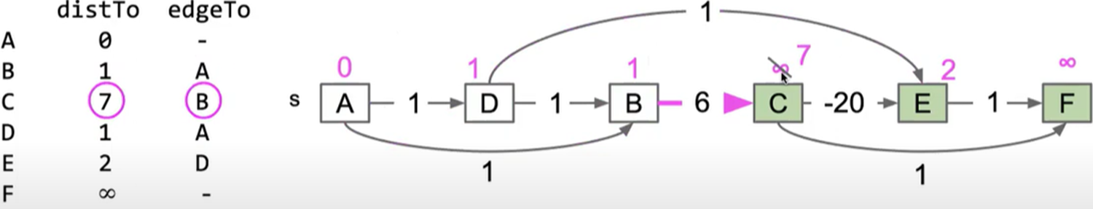
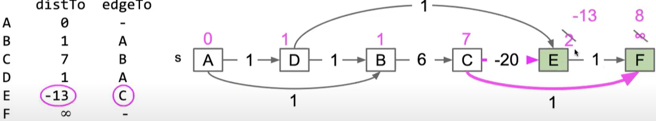
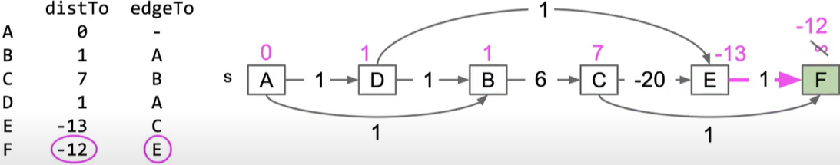
Visit B
Visit C
8
C
C
Visit E

Slide 40
Topological Sort Example I: Final Answer (for Exams
Visit Order
A, D, B, C, E, F
Node | SD | PN
A | 0 | /
B | 1 | A
C | 7 | B
D | 1 | A
E | 2 -13 | D C
F | 8 -12 | C E

Slide 41
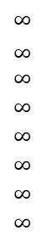
Topological Sort Example II
Consider this DAG and a topological order 01475236
V SD
Visit Order
0, 1, 4, 7, 5, 2, 3, 6
0
1
2
3
4
5
6
7
$$∞$$
$∞$ $∞$
$$∞$$
$$∞$$
$$∞$$
$$∞$$
$$∞$$
0
5
17
20
9
13
29
8
15
17
26
14
25
0 1 4 7 5 2 3 6
Node | SD | PN
0 | 0 | /
1 | 5 | 0
2 | 17 15 14 | 1 7 5
3 | 20 17 | 1 2
4 | 9 | 0
5 | 13 | 4
6 | 29 26 25 | 4 5 2
7 | 8 | 0
1
15
3
5
4
12
0
3
v PN
8
7
2
0
1
2
3
4
5
6
7
-
-
-
-
-
-
-
-
0
1
1
0
4
4
0
7
2
5
5
2
7
9
9
5
6
1
5
11
4
4
13
20
6

Slide 42
Single Source Shortest-paths Algorithms Summary
Algorithm | Restriction | Worst-Case Complexity
Dijkstra | Undirected or directed graph; no negative weights/cycles | O((V+E) log V)
Topological Sort | Directed Acyclic Graph (DAG) (no cycles, negative weights OK) | O(V+E)
Notes:
typical case
worst case O(VlogV+E)
Remark 1. Directed cycles make the problem harder.
Remark 2. Negative weights make the problem harder.
Remark 3. Negative cycles makes the problem ill-defined.
E+V
E+V
Dijkstra (binary heap)
E log V
E log V
Bellman-Ford
EV
EV

Slide 43
Review: Key Features
Once a node is marked known, its shortest path is known
Can reconstruct path by following backpointers
While a node is not known, another shorter path might be found
The order in which nodes are added to the known set is unimportant
If we only need path to a specific node, can stop early once that node is known
Because its shortest path cannot change!
Return a partial shortest path tree
Notes:
A detail about how the algorithm works (client doesn’t care)
Not used by the algorithm (implementation doesn’t care)
It is sorted by path-distance; ties are resolved “somehow”

Slide 44
Greedy Algorithms
At each step, do what seems best at that step
“instant gratification”
“make the locally optimal choice at each stage”
Dijkstra’s is “greedy” because once a node is marked as visited, it is never revisited
This is why Dijkstra’s does not work with negative edge weights
Other examples of greedy algorithms are:
Kruskal and Prim’s minimum spanning tree algorithms
Huffman compression

Slide 45
References
Dijkstras Shortest Path Algorithm Explained | With Example | Graph Theory
https://www.youtube.com/watch?v=bZkzH5x0SKU
Dijkstra's algorithm in 3 minutes
https://www.youtube.com/watch?v=_lHSawdgXpI
Geeksforgeeks topological sort
https://www.geeksforgeeks.org/topological-sorting-indegree-based-solution/

